Slide 1

Dynamic Programming
Read Chapter 3

Slide 2
What is Dynamic Programming?
Basic idea: One implicitly explores the space of all possible solutions by
carefully decomposing things into a series of sub problems
building up correct solutions to larger and larger sub problems
Can you smell the Divide & Conquer flavor?
However, Dynamic Programming is another story!
Dynamic Programming does NOT examine all possible solutions explicitly

Slide 3
Dynamic Programming
Similar to divide-and-conquer in that the problem instance is divided into smaller instances
It is a bottom-up approach
the small instances are solved first
their result is saved and retrieved later when needed instead of being recomputed
Dynamic Programming includes 2 steps
Establish a recursive property (a.k.a., recursive relation) that gives the solution to an instance of the problem
Solve an instance of the problem in a bottom-up fashion by solving smaller instances first
Dynamic programming sometimes
provide an efficient solution to a problem
for which divide-and-conquer produces an exponential run-time O(2ⁿ)

Slide 4
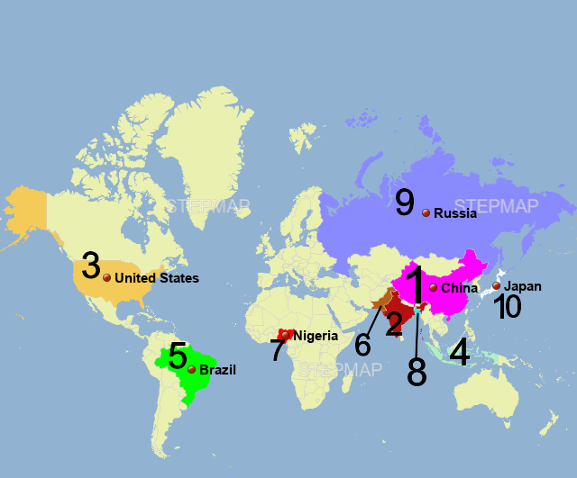
The Binomial Coefficient
Widely used in mathematics and statistics
Defined as the number of ways of choosing k objects out of n without regard to order
The number of combinations of k items that can be selected from a set of n items
If there are 10 countries on a map to choose from, and I commit to visiting only 3 of them, then n would equal 10, and k would equal 3. Result is 120
There are = 6 ways to choose 2 elements from {1,2,3,4}
Namely {1,2}, {1,3}, {1,4}, {2,3}, {2,4}, {3,4}
4
2
n
k
n!
k! (n - k)!
=
For 0 ≤ k ≤ n

Slide 5
The Binomial Coefficient
Binomial Coefficient
Computing the binomial coefficient by directly applying the above definition is not possible for large values of n and k, because n! is very large even for moderate values of n
Recursive property
Proof is provided in the textbook and requires several steps!
We can eliminate the need to compute n! or k! by using this recursive property
n
k
n!
k! (n - k)!
=
For 0 ≤ k ≤ n
(
)
(
)
(
n - 1
)
(
n - 1
)
n
n
(
n
)
+
for 0 < k < n
= 1
= 1
k - 1
k
0
n
k
=
(
n
)
(
n - 1
)
(
n - 1
)
=
+
1
for k = 0 or k = n
k
k - 1
k

Slide 6
The Binomial Coefficient (cont.)
The recursive property suggests the following Divide-and-Conquer algorithm
Algorithm 3.1
Binomial Coefficient Using Divide-and-Conquer
Problem: Compute the binomial coefficient.
Inputs: nonnegative integers n and k, where k ≤ n
Outputs: bin, the binomial coefficient
This algorithm is very inefficient
n
k
n - 1
k - 1
n - 1
k
=
+
n
k
int bin (int n, int k)
{
if (k==0 II n==k)
return 1;
else
return bin(n-1, k-1) + bin(n-1, k);
}

Slide 7

Java Code using Divide and Conquer technique
public class BinomialCoefficientRecursive {
// Recursive function to compute C(n, k)
public static int binomialCoeff(int n, int k) {
// Base Cases
if (k == 0 || k == n) {
return 1;
}
// Recursive relation: C(n, k) = C(n-1, k-1) + C(n-1, k)
return binomialCoeff(n - 1, k - 1) + binomialCoeff(n - 1, k);
}
// Driver code to test the function
public static void main(String[] args) {
int n = 4, k = 3;
System.out.println("C(" + n + ", " + k + ") = " + binomialCoeff(n, k));
}
}
Time Complexity: 𝑂(2^{𝑛}) (i.e., exponential) because each recursive call generates two more calls, creating a large binary tree.

Slide 8
The Binomial Coefficient (cont.)
The reason for the inefficiency is that same instances are solved in each recursive call
bin(n - 1, k - 1)
bin(n - 1, k)
Thus bin(n-2, k-1) is solved separately in each recursive call
Both need the result of bin(n - 2, k - 1)
(
n
)
(
n
)
= 1
= 1
0
n
(
n
)
(
n - 1
)
(
n - 1
)
=
+
k
k - 1
k
Both need to compute
(
n - 2
)
k - 1

Slide 9
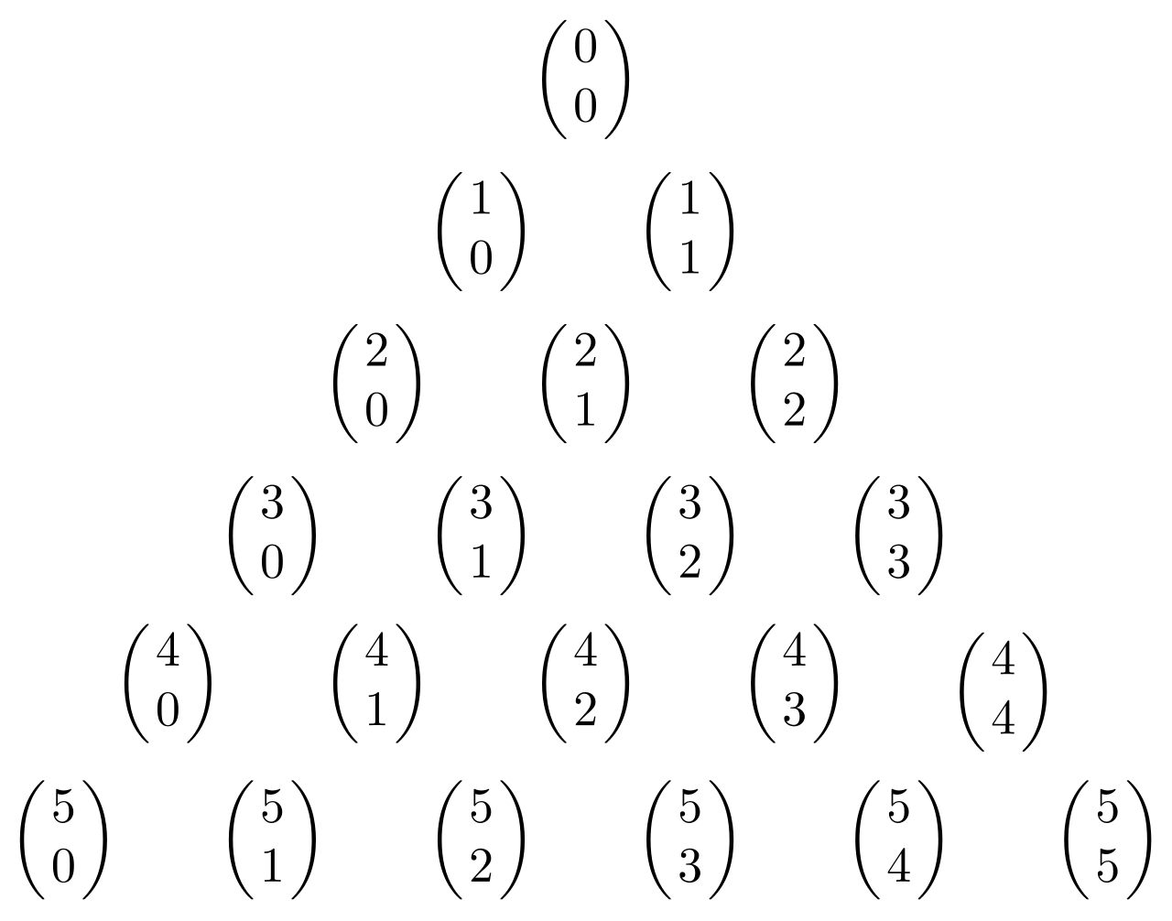
Dynamic Prg. For Binomial Coefficient
(
n
)
(
n - 1
)
(
n - 1
)
(
i
)
=
+
B[i] [j] will contain
k
k - 1
k
j
A dynamic programming algorithm for this problem
Establish a recursive property. This has already been done in Equality 3.1
1 j = 0 or j = i
2. Solve an instance of the problem in a bottom-up fashion by computing the rows in B in sequence starting with the first row
B [i] [j] = B [i-1] [j-1] + B[i-1] [j] 0 < j < i
Pascal's triangle:
0 1 2 3 4 j k
0
1
2
3
4
i
n
1
1
1
1
1
1
2
3
4
1
3
6
1
4
1
+
=
B[i][j] = B[i-1][j-1] + B[i-1][j]
https://www.mathsisfun.com/pascals-triangle.html

Slide 10
The Binomial Coefficient (cont.)
(
4
)
B[i][j] = B[i-1][j-1] + B[i-1][j]
Example:
Compute B[4][2] =
2
1 If j=0 or i=j
Compute row 0:
B[0][0] = 1
Compute row 1:
B[1][0]=1
B[1][1]=1
Compute row 2:
B[2][0] = 1
B[2][1] = B[1][0] + B[1][1] = 1 + 1 = 2
B[2][2] = 1
Compute row 3:
B[3][0] = 1
B[3][1] = B[2][0]+B[2][1] = 1+2 = 3
B[3][2] = B[2][1]+B[2][2] = 2+1 = 3
Compute row 4:
B[4][0] = 1
B[4][1] = B[3][0] + B[3][1] = 1+3 = 4
B[4][2] = B[3][1] + B[3][2] = 3+3 = 6

Slide 11
The Binomial Coefficient (cont.)
Algorithm 3.2
Binomial Coefficient Using Dynamic Programming
Problem: Compute the binomial coefficient
Inputs: nonnegative integers n and k, where k ≤ n
Outputs: bin2, the binomial coefficient
n
k
int bin2 (int n, int k)
{
index i, j;
int B[0..n] [0..k];
for (i = 0; i <= n; i++)
for (j = 0; j <= minimum (i, k); j++)
if (j = = 0 || j = = i)
B[i][j] = 1;
else
B[i][j] = B[i - 1][j - 1] + B[i - 1] [j];
return B[n][k];
}
Iterates through all possible values of n
Iterates through k; we only compute values that are needed
(since k cannot be greater than n)
Apply previously discussed equations

Slide 12
Java Code using Dynamic Programming (not space optimized)
public class BinomialCoefficient {
public static int binomialCoeff(int n, int k) {
int B[][] = new int[n + 1][k + 1];
// Bottom-up DP approach
for (int i = 0; i <= n; i++) {
for (int j = 0; j <= Math.min(i, k); j++) {
// Base cases
if (j == 0 || j == i) {
B[i][j] = 1;
} else {
// DP relation: B(n, k) = B(n-1, k-1) + B(n-1, k)
B[i][j] = B[i - 1][j - 1] + B[i - 1][j];
}
}
}
return B[n][k];
}
public static void main(String[] args) {
int n = 4, k = 3;
System.out.println("C(" + n + ", " + k + ") = " + binomialCoeff(n, k));
}
}

Slide 13
Analysis of the Algorithm
int bin2 (int n, int k)
{
for (i = 0; i <= n; i++)
for (j = 0; j <= minimum (i, k); j++)
if (j = = 0 || j = = i)
B[i][j] = 1;
else
B[i][j] = B[i - 1][j - 1] + B[i - 1] [j];
return B[n[k];
}
O(nk)
Much better than
O(2^{n}) which is the complexity of recursive Divide and Conquer approach
Outer loop: It runs from i = 0 to i = n, so it iterates n + 1 times
Inner loop: It runs from j = 0 to min(i, k)
For i ≤ k, the loop runs i + 1 times
For i > k, it runs exactly k + 1 times (since min(i, k) = k)
Total Iterations:
For small i (i.e., when i ≤ k), the inner loop runs up to k times, which gives us a total of 𝑂(𝑘²) operations
For larger i (i.e., when i > k), the inner loop runs k times for each i, resulting in 𝑂(𝑛𝑘) operations
Since 𝑂(𝑛𝑘) dominates 𝑂(𝑘²), the overall time complexity is: 𝑂(𝑛𝑘)
For i ≤ k; The total number of iterations for the inner loop is the sum: 1+2+3+⋯+k+1 = k(k+1) / 2 = k²
For i > k; the inner loop runs exactly k + 1 times for each i. There are (𝑛−𝑘) such iterations (from i = k + 1 to i = n).
Therefore, the total work is 𝑂(𝑛𝑘).

Slide 14
Wrap Up
By using dynamic programming instead of divide-and-conquer
we have developed a much more efficient algorithm
Dynamic programming is similar to divide-and-conquer in that we find a recursive property that divides an instance into smaller instances
The difference is that in dynamic programming we use the recursive property to iteratively solve the instances in sequence, starting from the smallest instance
This way, we solve each smaller instance just once
Dynamic programming is a good technique to try when divide-and-conquer leads to an inefficient algorithm

Slide 15
Brief Review of Graph Theory – Terminology I
Unweighted Undirected Graph
Graph: A graph consists of a set of vertices and a set of edges that connect pairs of vertices; G = (V, E) where V is a set of vertices, E a set of edges.
Vertex (node): Represents one of the objects that are connected together
Edge (arc/link): Connection (line/link) between two vertices
Directed Graph (Digraph): A graph where edges have a direction
Undirected Graph: A graph where edges do not have a direction
Adjacent Vertices: Two vertices are said to be adjacent, if there is an edge between the two vertices
Weighted Graph: A graph where edges have values called weights
Unweighted Graph: A graph where edges do not have weights
Weighted Directed Graph: Graph where edges have a direction and a weight
Unweighted Undirected Graph: A graph where edges do not have a direction and do not have a weight
v₁
v₂
v₅
v₄
v₃
Weighted Directed Graph
Weights
Edges (arcs)
Vertices
1
v₁
v₂
3
9
v₅
5
2
3
3
v₄
2
v₃
4

Slide 16
Graph Representation : Adjacency Matrix
Weighted Graph containing n vertices
can be represented by an Adjacency Matrix
Weight on edge if there is an edge from v_{i} to v_{j}
∞ if there is no edge from v_{i} to v_{j}
0 if i = j
W[i][j] =
Vertices
Adjacency Matrix
W | 1 | 2 | 3 | 4 | 5
1 | 0 | 1 | ∞ | 1 | 5
2 | 9 | 0 | 3 | 2 | ∞
3 | ∞ | ∞ | 0 | 4 | ∞
4 | ∞ | ∞ | 2 | 0 | 3
5 | 3 | ∞ | ∞ | ∞ | 0
Weights
on Edges
1
v₁
v₂
3
9
v₅
5
2
1
3
3
v₄
2
v₃
4

Slide 17
Graph Representation: Adjacency Matrix (cont.)
Unweighted Undirected Graph containing n vertices
can also be represented by an Adjacency Matrix
1 if there is an edge between v_{i} and v_{j}
0 if there is no edge between v_{i} and v_{j}
0 if i = j
W[i][j] =
The Adjacency Matrix is symmetric
Unweighted Undirected Graph
Vertices
Adjacency Matrix
Edges
W | 1 | 2 | 3 | 4 | 5
1 | 0 | 1 | 0 | 1 | 1
2 | 1 | 0 | 1 | 1 | 0
3 | 0 | 1 | 0 | 1 | 0
4 | 1 | 1 | 1 | 0 | 1
5 | 1 | 0 | 0 | 1 | 0
v₁
v₂
v₅
v₄
v₃

Slide 18
Brief Review of Graph Theory – Terminology II
Weighted Directed Graph
Path: Sequence of vertices connected by edges
Simple path: A path is simple if it never passes through same vertex twice
Length of a Path:
Weighted graph: Sum of the weights on the path
Unweighted graph: Number of edges in the path
Cycle: It is a path where the first and last vertices are the same
Cyclic Graphs: A graph is cyclic if it contains a cycle
Acyclic graphs: Acyclic graph is a graph that does not contain a cycle
Tour (Hamiltonian Circuit): In a directed graph, it is a path from a vertex to itself that passes through each of the other vertices exactly once
1
v₁
v₂
3
9
v₅
5
2
1
3
3
v₄
2
v₃
4
Cycle
Tour
Path

Slide 19
The Shortest Path Problem
1
v₁
v₂
3
9
Shortest path: Optimization problem
v₅
5
2
3
1
3
v₄
2
v₃
4
Paths from v₁ to v_{3:}
length [v₁ , v₂ , v₃] = 1 + 3 = 4
length [v₁ , v₄ , v₃] = 1 + 2 = 3 → Shortest path
length [v₁ , v₂ , v₄, v₃] = 1 + 2 + 2 = 5
Many candidate solutions
- Each candidate solution has a value associated with it
- The solution is the one that has an optimal value

Slide 20
Trivial Algorithm For Shortest Paths
1
v₁
v₂
3
Shortest path from v₁ to v₃
There could be many optimal solutions
We need to find one of them
9
v₅
5
2
1
3
3
v₄
2
v₃
4
Trivial Algorithm Idea
Determine the length from each vertex to all other vertices
Find the path with the minimum length
From v₁ to v₃
- from v₁ to all neighbor vertices other than destination (adjacent vertices): n-2 choices
- from any of n-2 neighbors to their neighbors, …etc. n-3 choices
Total number of paths: (n-2) (n-3) (n-4)…. 1 = (n – 2) !
Worse than exponential!
∈ ϴ (n!)

Slide 21
Related Shortest Path Algorithms
Dijkstra
Shortest path from one node to all nodes
Negative edges are NOT allowed
Bellman-Ford
Shortest path from one node to all nodes
Negative edges allowed
Floyd – Warshall (Floyd's algorithm)
Shortest path between all pairs of vertices
Negative edges allowed
Published by Robert Floyd in 1962
Also, by Stephen Warshall in 1962
GREEDY APPROACH
DYNAMIC PROGRAMMING
ALGORITHM IN OUR TEXTBOOK
DYNAMIC PROGRAMMING

Slide 22
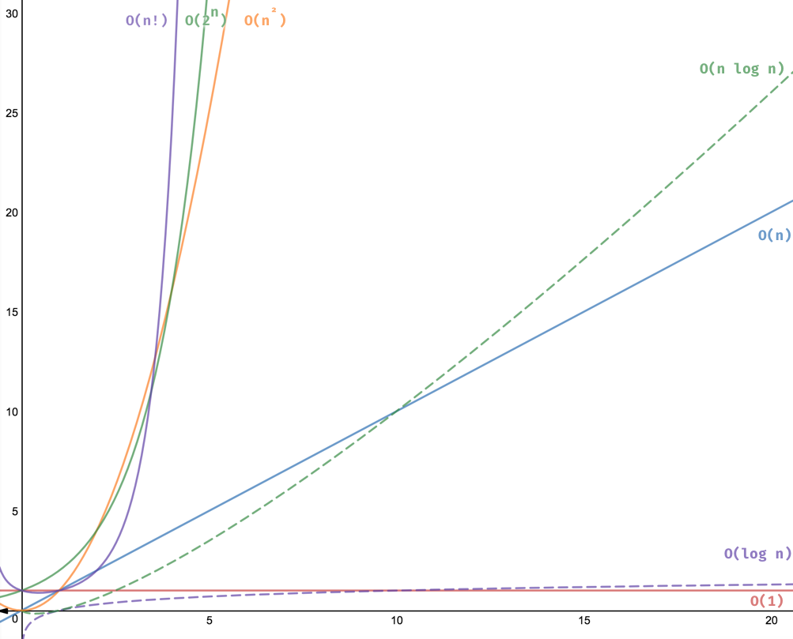
Dynamic Programming for the Shortest Paths Problem
We create a cubic-time algorithm for the Shortest Paths problem
First, we develop an algorithm that determines only the lengths of the shortest paths
After that, we modify it to produce shortest paths as well

Slide 23
Floyd’s Algorithm For Shortest Paths
W | 1 | 2 | 3 | 4 | 5
1 | 0 | 1 | ∞ | 1 | 5
2 | 9 | 0 | 3 | 2 | ∞
3 | ∞ | ∞ | 0 | 4 | ∞
4 | ∞ | ∞ | 2 | 0 | 3
5 | 3 | ∞ | ∞ | ∞ | 0
1
v₁
v₂
3
9
v₅
5
1
2
3
3
v₄
2
v₃
4
Problem: Compute D from W
Solution: Create a sequence of n +1 arrays D^{(k)} , 0 ≤ k ≤ n, where
D^{(k)}[i][j] = length of shortest path from v_{i} to v_{j} using only vertices in the set {v₁, v₂, …, v_{k}} as intermediate vertices
D⁰ : adjacency matrix, D¹ : Is there any shortest path via vertex 1?
D² : Is there any shortest path via vertex 2?
…
D | 1 | 2 | 3 | 4 | 5
1 | 0 | 1 | 3 | 1 | 4
2 | 8 | 0 | 3 | 2 | 5
3 | 10 | 11 | 0 | 4 | 7
4 | 6 | 7 | 2 | 0 | 3
5 | 3 | 4 | 6 | 4 | 0

Slide 24
Dynamic Programming for Shortest Path Problem
Dynamic programming steps
Establish a recursive property to compute D^{(k)} from D^{(k-1)}
Solve an instance of the problem in a bottom-up fashion using the recursive property
That is, compute D⁽⁰⁾ then D⁽¹⁾ then …. then D^{(n)}
D⁽⁰⁾[i][j] = length of shortest path from v_{i} to v_{j} that is not allowed to pass through any other vertices
= weight on the edge from v_{i} to v_{j}
D^{(n)}[i][j] = length of shortest path from v_{i} to v_{j} that is allowed to pass through any of the other vertices
= length of shortest path v_{i} to v_{j}
Finding the recursive property: compute D^{(k)} from D^{(k-1)}
To do so, let’s consider two cases
- Shortest path does not include vertex v_{k}
- Shortest path does include vertex v_{k}

Slide 25
Recurrence Property for Shortest Paths -I-
D^{(k-1)}[i][j]
D^{(k)}[i][j]
Shortest path between
v_{i} and v_{j} that considers
all vertices v₁, ... , v_{k-1}
v_{i}
v_{j}
v_{i}
v_{j}
vertices from v₁, ... , v_{k-1}
vertices from v₁, ... , v_{k-1} , v_{k}
Case 1: v_{k} not used
D^{(k)}[i][j] = D^{(k-1)}[i][j]
v_{i}
v_{j}
vertices from v₁, ... , v_{k}
Case 2: v_{k} is used
D^{(k)}[i][j] = D^{(k-1)}[i][k] + D^{(k-1)}[k][j]
v_{j}
v_{i}
v_{k}
Minimum length between
Case 1 & Case 2
D^{(k)}[i][j] =
vertices from v₁, ... , v_{k-1}
vertices from v₁, ... , v_{k-1}

Slide 26
Recurrence Property for Shortest Paths -II-
We have either case 1 or case 2, then:
D^{(k)}[i][j] = minimum ( D^{(k-1)}[i][j], D^{(k-1)}[i][k] + D^{(k-1)}[k][j] )
1
Example :
D¹ | 1 | 2 | 3 | 4 | 5
1 | 0 | 1 | ∞ | 1 | 5
2 | 9 | 0 | 3 | 2 | 14
3 | ∞ | ∞ | 0 | 4 | ∞
4 | ∞ | ∞ | 2 | 0 | 3
5 | 3 | 4 | ∞ | 4 | 0
v₁
v₂
D⁰ | 1 | 2 | 3 | 4 | 5
1 | 0 | 1 | ∞ | 1 | 5
2 | 9 | 0 | 3 | 2 | ∞
3 | ∞ | ∞ | 0 | 4 | ∞
4 | ∞ | ∞ | 2 | 0 | 3
5 | 3 | ∞ | ∞ | ∞ | 0
3
9
v₅
5
1
2
3
3
v₄
2
v₃
4
D¹: First row and first column do not always change. Also, diagonal elements are 0 (zero)
Other elements need to be computed as follows
D¹[2][4] = min(D⁰[2][4], D⁰[2][1] + D⁰[1][4]) = min(2, 9+1) = 2
D¹[5][2] = min(D⁰[5][2], D⁰[5][1] + D⁰[1][2]) = min(∞, 3+1) = 4
D¹[5][4] = min(D⁰[5][4], D⁰[5][1] + D⁰[1][4]) = min(∞, 3+1) = 4

Slide 27
D⁰ | 1 | 2 | 3 | 4 | 5
1 | 0 | 1 | ∞ | 1 | 5
2 | 9 | 0 | 3 | 2 | ∞
3 | ∞ | ∞ | 0 | 4 | ∞
4 | ∞ | ∞ | 2 | 0 | 3
5 | 3 | ∞ | ∞ | ∞ | 0
D¹ | 1 | 2 | 3 | 4 | 5
1 | 0 | 1 | ∞ | 1 | 5
2 | 9 | 0 | 3 | 2 | 14
3 | ∞ | ∞ | 0 | 4 | ∞
4 | ∞ | ∞ | 2 | 0 | 3
5 | 3 | 4 | ∞ | 4 | 0
D² | 1 | 2 | 3 | 4 | 5
1 | 0 | 1 | 4 | 1 | 5
2 | 9 | 0 | 3 | 2 | 14
3 | ∞ | ∞ | 0 | 4 | ∞
4 | ∞ | ∞ | 2 | 0 | 3
5 | 3 | 4 | 7 | ? | 0
D³ | 1 | 2 | 3 | 4 | 5
1 | 0 | 1 | 4 | 1 | 5
2 | 9 | 0 | 3 | 2 | 14
3 | ∞ | ? | 0 | 4 | ∞
4 | ∞ | ∞ | 2 | 0 | 3
5 | 3 | 4 | 7 | 4 | 0
D⁴ | 1 | 2 | 3 | 4 | 5
1 | 0 | 1 | 3 | 1 | 4
2 | 9 | 0 | 3 | 2 | 5
3 | ∞ | ? | 0 | 4 | 7
4 | ∞ | ∞ | 2 | 0 | 3
5 | 3 | 4 | 6 | 4 | 0
D⁵ | 1 | 2 | 3 | 4 | 5
1 | 0 | 1 | 3 | 1 | 4
2 | 8 | 0 | 3 | 2 | 5
3 | 10 | ? | 0 | 4 | 7
4 | 6 | 7 | 2 | 0 | 3
5 | 3 | 4 | 6 | 4 | 0
D²[5][4] = ?
D⁴[5][3] = ?
D⁴[2][5] = ?
D⁴[3][2] = ?
D⁵[3][2] = ?

Slide 28
D¹ | 1 | 2 | 3 | 4 | 5
1 | 0 | 1 | ∞ | 1 | 5
2 | 9 | 0 | 3 | 2 | 14
3 | ∞ | ∞ | 0 | 4 | ∞
4 | ∞ | ∞ | 2 | 0 | 3
5 | 3 | 4 | ∞ | 4 | 0
D² | 1 | 2 | 3 | 4 | 5
1 | 0 | 1 | 4 | 1 | 5
2 | 9 | 0 | 3 | 2 | 14
3 | ∞ | ∞ | 0 | 4 | ∞
4 | ∞ | ∞ | 2 | 0 | 3
5 | 3 | 4 | 7 | 4 | 0
D³ | 1 | 2 | 3 | 4 | 5
1 | 0 | 1 | 4 | 1 | 5
2 | 9 | 0 | 3 | 2 | 14
3 | ∞ | ∞ | 0 | 4 | ∞
4 | ∞ | ∞ | 2 | 0 | 3
5 | 3 | 4 | 7 | 4 | 0
D⁴ | 1 | 2 | 3 | 4 | 5
1 | 0 | 1 | 3 | 1 | 4
2 | 9 | 0 | 3 | 2 | 5
3 | ∞ | ∞ | 0 | 4 | 7
4 | ∞ | ∞ | 2 | 0 | 3
5 | 3 | 4 | 6 | 4 | 0
D⁵ | 1 | 2 | 3 | 4 | 5
1 | 0 | 1 | 3 | 1 | 4
2 | 8 | 0 | 3 | 2 | 5
3 | 10 | 11 | 0 | 4 | 7
4 | 6 | 7 | 2 | 0 | 3
5 | 3 | 4 | 6 | 4 | 0
D²[5][4] = min(D¹[5][4], D¹[5][2] + D¹[2][4]) = min(4,4+2) = 4
D⁴[5][3] = min(D³[5][3], D³[5][4] + D³[4][3]) = min(7,4+2) = 6
D⁴[2][5] = min(D³[2][5], D³[2][4] + D³[4][5]) = min(14, 2+3) = 5
D⁴[3][2] = min(D³[3][2], D³[3][4] + D³[4][2]) = min(∞,4+ ∞) = ∞
D⁵[3][2] = min(D⁴[3][2], D⁴[3][5] + D⁴[5][2]) = min(∞,7+4) = 11

Slide 29
Floyd’s Algorithm for Determining only the lengths of the shortest paths
void floyd (int n, const number W[ ][ ],
number D[ ][ ])
{
index i, j, k;
D = W;
for (k = 1; k <= n; k++)
for (i = 1; i <= n; i++)
for (j = 1; j <= n; j++)
D[i][j] = min( D[i][j], D[i][k]+D[k][j] );
}
Basic Operation:
Statement within inner for loop
Every Case Time complexity:
Three nested loops
Each loop is executed n times
T(n) = n³ is in θ(n³)
Cover D⁽¹⁾ to D^{(n)}
Cover rows
Cover columns
for row i
We had to generate 5 matrices (D1, …D4)
For each matrix, n*n elements have been generated
W | 1 | 2 | 3 | 4 | 5
1 | 0 | 1 | ∞ | 1 | 5
2 | 9 | 0 | 3 | 2 | ∞
3 | ∞ | ∞ | 0 | 4 | ∞
4 | ∞ | ∞ | 2 | 0 | 3
5 | 3 | ∞ | ∞ | ∞ | 0
D | 1 | 2 | 3 | 4 | 5
1 | 0 | 1 | 3 | 1 | 4
2 | 8 | 0 | 3 | 2 | 5
3 | 10 | 11 | 0 | 4 | 7
4 | 6 | 7 | 2 | 0 | 3
5 | 3 | 4 | 6 | 4 | 0

Slide 30
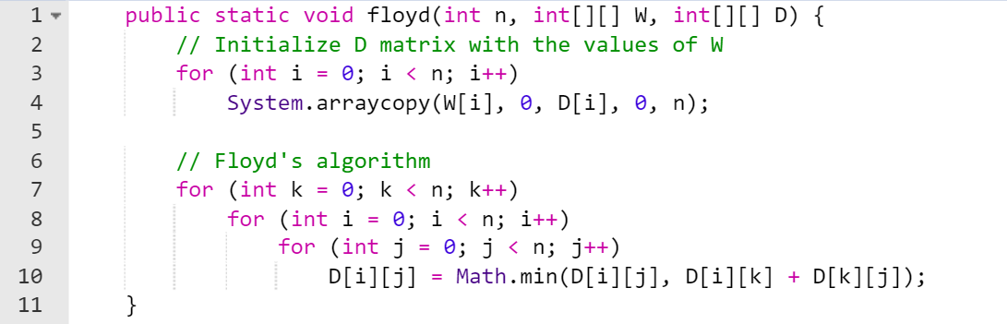
Java Code for Determining only the lengths of the shortest paths

Slide 31
Floyd’s Alg. for producing Shortest Paths
Previous Algorithm finds the shortest path but no indication on the path itself (i.e., sequence of vertices)
P[i] [j]: Intermediate vertex matrix or Path matrix or Predecessor matrix
It helps reconstruct the shortest path by storing intermediate predecessor (or via) vertices
P[i] [j] = { highest index of an intermediate vertex on the shortest path from v_{i} to v_{j}, if at least one intermediate vertex exists
0, if no intermediate vertex exists}
void floyd2 (int n, const number W[ ][ ],
number D[ ][ ],
index P[ ][ ])
{
index i, j, k;
for (i = 1; i <= n; i++)
for (j = 1; j <= n; j++)
P[i][j] = 0; //intermediate vertex matrix
D = W;
for (k = 1; k <= n; k++)
for (i = 1; i <= n; i++)
for (j = 1; j <= n; j++)
if (D[i][k]+D[k][j] < D[i][j]) {
P[i][j] = k;
D[i][j] = D[i][k]+D[k][j];
}
}
Initialize P to 0
Initialize D with the values of W and keep W unchanged
v_{k} is used in
shortest path
P[1][3] = 4
P | 1 | 2 | 3 | 4 | 5
1 | 0 | 0 | 4 | 0 | 4
2 | 5 | 0 | 0 | 0 | 4
3 | 5 | 5 | 0 | 0 | 4
4 | 5 | 5 | 0 | 0 | 0
5 | 0 | 1 | 4 | 1 | 0
Recursive property:
D[i][j] = min(D[i][j], D[i][k]+D[k][j]);

Slide 32
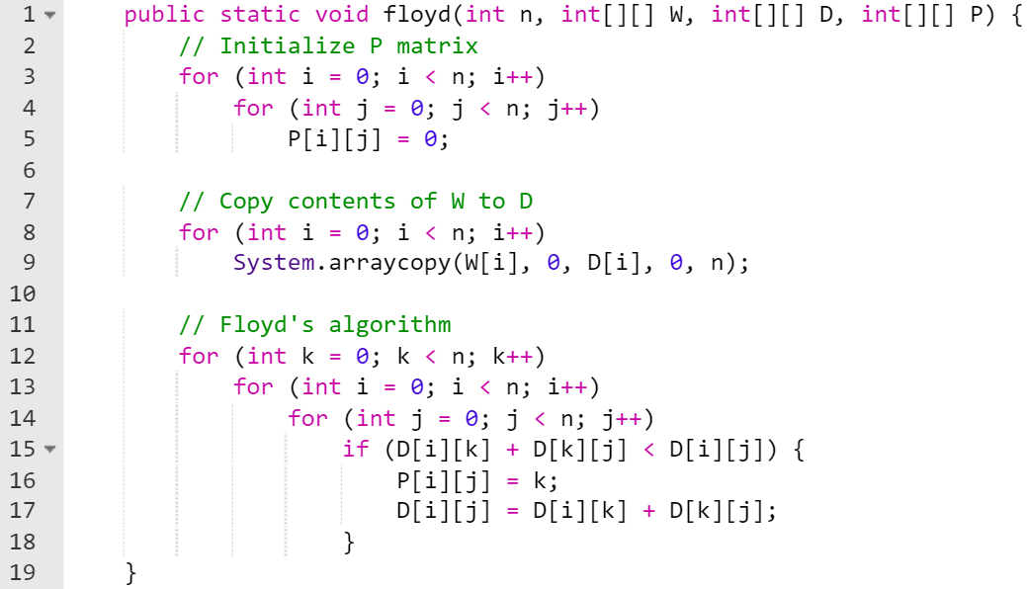
Java Code for producing Shortest Paths

Slide 33
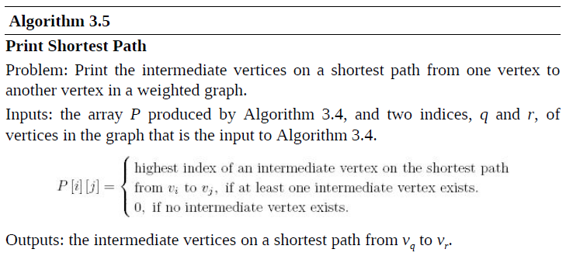
Printing the Shortest Path
1
v₁
v₂
3
9
v₅
5
2
3
3
v₄
2
v₃
4
Tracing the Execution of path(5,3)
Path(5,3)
Path(5,4)
cout << v₄
Path(4,3)
Path(5,1)
cout << v₁
Path(1,4)
void path (int q, int r) {
if (P[q][r] != 0) { //Check if there is an intermediate node
path (q, P[q][r] ); //Recursive call for the first half of the path
System.out.print("v" + P[q][r] ); //Print intermediate vertex
path( P[q][r], r); //Recursive call for the second half of the path
}
}
Test Run:
path(5,3)
path(5,4)
path(5,1)
v₁
path(1,4)
v₄
path(4,3)
P | 1 | 2 | 3 | 4 | 5
1 | 0 | 0 | 4 | 0 | 4
2 | 5 | 0 | 0 | 0 | 4
3 | 5 | 5 | 0 | 0 | 4
4 | 5 | 5 | 0 | 0 | 0
5 | 0 | 1 | 4 | 1 | 0

Slide 34
Java code for printing the shortest path
static void path(int q, int r) {
if (P[q][r] != 0) { // Check if there is an intermediate vertex
path(q, P[q][r]); // First half of the path
System.out.print("v" + P[q][r] + " → "); //Print intermediate vertex
path(P[q][r], r); // Second half of the path
}
}
//If you want to use the above code, the arrays must be declared as follows
//Otherwise, subtract 1 from P[q][r] in the code above if you use 0-based indexing
int[][] D = new int[n + 1][n + 1]; // Use 1-based indexing
P = new int[n + 1][n + 1]; // Path matrix with 1-based indexing

Slide 35
Dynamic Programming and Optimization Problems
Dynamic Programming can be also used to solve optimization problems such as the shortest path problem
Dynamic Programming for Optimization Problems
requires a third step which is to construct the optimal solution
Thus, there must be 3 steps
Establish a recursive property that gives the optimal solution of the problem
Compute the optimal solution in a bottom-up fashion
Construct the optimal solution in a bottom up fashion
Not every optimization problem can be solved using dynamic programming
Dynamic programming solves only those problems for which the
principle of optimality holds

Slide 36
3 Steps used for Floyd’s Shortest Path Algorithm
Step 1: Establish a Recursive Property: Define the recursive relation for the shortest path: 𝐷_{𝑘}[𝑖][𝑗] = min⁡( 𝐷_{𝑘−1}[𝑖][𝑗] , 𝐷 _{𝑘−1}[𝑖][𝑘] + 𝐷 _{𝑘−1}[𝑘][𝑗] )
Step 2: Compute the Optimal Solution (Bottom-Up): Fill the distance table by iteratively considering each node as an intermediate and updating the shortest path distances
Step 3: Construct the Optimal Solution (Bottom-Up): Reconstruct the shortest paths by using a predecessor matrix (P) to trace the sequence of nodes along the optimal path.

Slide 37
The Principle of Optimality
Definition:
The principle of optimality applies to a problem
if an optimal solution to the problem always includes optimal solutions to all sub problems
Principle of optimality:
Suppose that in solving a problem, we have to make a sequence of decisions D₁, D₂, …, D_{n}.
If this sequence is optimal, then the last k decisions must be optimal (1 < k < n)
e.g., the shortest path problem
If i, i₁, i₂, …,i_{k}, …, j is a shortest path from i to j
then the path i to i_{k} and i_{k} to j are also shortest paths

Slide 38
Dynamic Programming and Principle of Optimality
If the principle of optimality holds in a given problem
we can find a recursive property
The recursive property gives an optimal solution to a problem
in terms of optimal solutions to smaller problems
Before using dynamic programming
it is necessary to show that the principle of optimality holds
1
v₂
4
Example: Longest Path (only simple paths, no cycle!)
from v₁ to v₄ is [v₁,v₃,v₂,v₄] = 7
However [v₁,v₃] is not longest path (just 1)
from v₁ to v₃. Consider [v₁,v₂,v₃] = 4
v₁
v₄
1
3
2
v₃
The principle of optimality does not apply in this example !

Slide 39
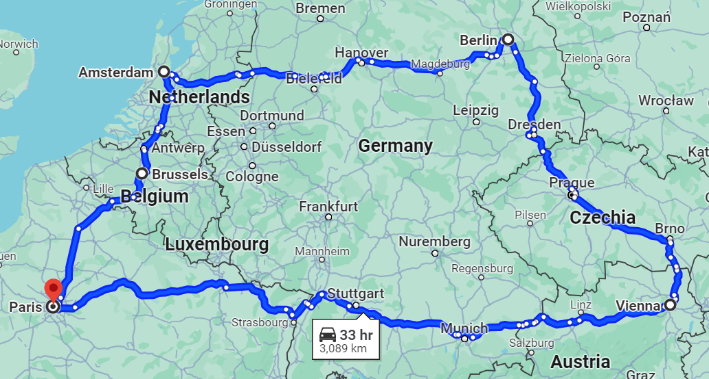
The Traveling Salesperson Problem (TSP)
A salesperson has a number of cities he must visit, find the shortest route (tour)
Starts and ends at the same city
Visits all cities
Each city is visited exactly once (Paris, Brussels, Amsterdam, Berlin, Vienna, Paris)
Possible tours from v₁ back to v₁
length [v₁ , v₂ , v₃ , v₄ , v₁] = 22
length [v₁ , v₃ , v₂ , v₄ , v₁] = 26
length [v₁ , v₃ , v₄ , v₂ , v₁] = 21 → Optimal (shortest) Tour
Traveling Salesperson problem is an optimization problem
Note: Starting city is irrelevant to the length of the optimal tour.
A Tour is a Cycle (Hamiltonian Circuit)
2
W | 1 | 2 | 3 | 4
1 | 0 | 2 | 9 | ∞
2 | 1 | 0 | 6 | 4
3 | ∞ | 7 | 0 | 8
4 | 6 | 3 | ∞ | 0
v₁
1
v₂
3
6
4
7
6
9
v₄
v₃
8
Notes:
Imagine you are a Talabat delivery rider in Doha, but instead of receiving orders one by one, you are assigned a batch of five orders at the beginning of your shift. These orders must all be picked up from a central Talabat hub at The Pearl-Qatar before being delivered to customers across the city.
Scenario: You start at The Pearl-Qatar (your pickup hub), and you need to deliver orders to customers at the following locations:
Education City, 2. Villaggio Mall (nearby residences), 3. Katara Cultural Village,
4. Aspire Zone, 5. West Bay
After delivering all the orders, you must return to The Pearl-Qatar to prepare for the next shift.
The Problem: What is the shortest possible route that allows you to:
Pick up orders from the hub (The Pearl-Qatar)
Visit each delivery location exactly once
Return to The Pearl-Qatar after completing all deliveries
This is the Classic Travelling Salesman Problem (TSP), where the goal is to find the most efficient circular route that minimizes total travel distance or time.
Why is TSP important?
TSP is widely used in logistics, transportation, and route planning, such as:
Delivery services (Talabat, UPS, FedEx)
Ride-hailing apps (Uber, Careem, Karwa taxis)
Autonomous vehicles & drones (optimizing movement paths)
By solving TSP efficiently, businesses can save fuel, reduce costs, and deliver faster service, which is critical in a fast-paced city like Doha.

Slide 40
Trivial Algorithm For Traveling Salesperson
Shortest route from v₁ back to v₁ passing by all other vertices exactly once
There could be many optimal solutions. We need to find one of them
Trivial Algorithm Idea
Consider all possible tours and find the optimal one
- from v₁ to all neighbor vertices (adjacent vertices): (n-1) choices
- from any of n-1 neighbors to their neighbors, …etc. (n-2) choices
Total number of paths: (n-1)(n-2) …. 1 = (n - 1) !
All possible tours: (n-1)!
3 ! = 3 * 2 * 1 = 6
v₁
2
9
5
1st Level: n-1 choices
v₂
v₃
v₄
6
4
7
3
8
4
2nd Level: n-2 choices
v₃
v₄
v₂
v₄
v₃
v₂
v₁
2
v₂
3
8
4
4
7
6
1
4
4
3rd Level: n-3 choices
v₄
v₃
v₄
v₂
v₂
v₃
9
4
7
6
6
5
6
4
6
1
1
4
v₄
3
v₃
v₁
v₁
v₁
v₁
v₁
v₁
8
2+6+3+6=17
18
26
17
21
19

Slide 41
Traveling Salesperson: Finding The Recursive Property
2
v₁
1
v₂
3
v₁
6
4
7
6
9
v₄
v₃
v₂
v₃
v₄
8
v₃
v₄
v₂
v₄
v₃
v₂
W | 1 | 2 | 3 | 4
1 | 0 | 2 | 9 | ∞
2 | 1 | 0 | 6 | 4
3 | ∞ | 7 | 0 | 8
4 | 6 | 3 | ∞ | 0
v₄
v₃
v₄
v₂
v₂
v₃
v₁
v₁
v₁
v₁
v₁
v₁
Solve in a Bottom up fashion: Start from bottom of the tree and solve as you move up

Slide 42
Traveling Salesperson: Finding The Recursive Property (cont.)
2
v₁
1
v₂
3
v₁
6
4
7
6
9
v₄
v₃
v₂
v₃
v₄
8
v₃
v₄
v₂
v₄
v₃
v₂
W | 1 | 2 | 3 | 4
1 | 0 | 2 | 9 | ∞
2 | 1 | 0 | 6 | 4
3 | ∞ | 7 | 0 | 8
4 | 6 | 3 | ∞ | 0
Distance to go
from 4 to 1 = 6
∞
6
1
1
∞
6
v₄
v₃
v₄
v₂
v₂
v₃
v₁
v₁
v₁
v₁
v₁
v₁
Solve in a Bottom up fashion: Start from bottom of the tree and solve as you move up

Slide 43
Example (from the Textbook)
2
v₁
1
v₂
3
v₁
6
4
7
6
9
v₄
v₃
v₂
v₃
v₄
8
8+6=14
∞+∞=∞
4+6=10
3+1=4
7+1=8
6+∞=∞
Distance from 3 to 1 =
from 3 to 4 + 4 to 1 =
8 + 6 = 14
v₃
v₄
v₂
v₄
v₃
v₂
W | 1 | 2 | 3 | 4
1 | 0 | 2 | 9 | ∞
2 | 1 | 0 | 6 | 4
3 | ∞ | 7 | 0 | 8
4 | 6 | 3 | ∞ | 0
Distance to go
from 4 to 1 = 6
∞
6
1
1
∞
6
v₄
v₃
v₄
v₂
v₂
v₃
v₁
v₁
v₁
v₁
v₁
v₁
Solve in a Bottom up fashion: Start from bottom of the tree and solve as you move up

Slide 44
Example (from the Textbook)
2
v₁
1
v₂
3
Distance from 2 to 1 =
minimum of:
from 2 to 3 + 3 to 1 =
from 2 to 4 + 4 to 1 =
v₁
6
4
7
6
9
min( 6+14 , 4+∞ ) = 20
min( 7+10 , 8+4 ) = 12
min( ∞+8 , 3+∞ )=∞
v₄
v₃
v₂
v₃
v₄
8
8+6=14
∞+∞=∞
4+6=10
3+1=4
7+1=8
6+∞=∞
Distance from 3 to 1 =
from 3 to 4 + 4 to 1 =
8 + 6 = 14
v₃
v₄
v₂
v₄
v₃
v₂
W | 1 | 2 | 3 | 4
1 | 0 | 2 | 9 | ∞
2 | 1 | 0 | 6 | 4
3 | ∞ | 7 | 0 | 8
4 | 6 | 3 | ∞ | 0
Distance to go
from 4 to 1 = 6
∞
6
1
1
∞
6
v₄
v₃
v₄
v₂
v₂
v₃
v₁
v₁
v₁
v₁
v₁
v₁
Solve in a Bottom up fashion: Start from bottom of the tree and solve as you move up

Slide 45
Example (from the Textbook)
2
v₁
1
v₂
min( 2+20 , 9+12, ∞+∞ ) = 21
3
Distance from 2 to 1 =
minimum of:
from 2 to 3 + 3 to 1 =
from 2 to 4 + 4 to 1 =
v₁
6
4
7
6
9
min( 6+14 , 4+∞ ) = 20
min( 7+10 , 8+4 ) = 12
min( ∞+8 , 3+∞ )=∞
v₄
v₃
v₂
v₃
v₄
8
8+6=14
∞+∞=∞
4+6=10
3+1=4
7+1=8
6+∞=∞
Distance from 3 to 1 =
from 3 to 4 + 4 to 1 =
8 + 6 = 14
v₃
v₄
v₂
v₄
v₃
v₂
W | 1 | 2 | 3 | 4
1 | 0 | 2 | 9 | ∞
2 | 1 | 0 | 6 | 4
3 | ∞ | 7 | 0 | 8
4 | 6 | 3 | ∞ | 0
Distance to go
from 4 to 1 = 6
∞
6
1
1
∞
6
v₄
v₃
v₄
v₂
v₂
v₃
v₁
v₁
v₁
v₁
v₁
v₁
Solve in a Bottom up fashion: Start from bottom of the tree and solve as you move up

Slide 46
Example (from the Textbook)
Distance from v₁ to v₁ passing by the set of vertices {v₂,v₃,v₄}: D[ v₁, {v₂,v₃,v₄} ]
D[ v₁, {v₂,v₃,v₄} ] = minimum ( W[1][j] + D[ j , {v₂,v₃,v₄} - {v_{j}}] )
2
v₁
1
v₂
2 ≤ j ≤ n
3
6
4
7
6
min( 2+20 , 9+12, ∞+∞ ) = 21
Distance from 2 to 1 =
minimum of:
from 2 to 3 + 3 to 1 =
from 2 to 4 + 4 to 1 =
v₁
9
v₄
v₃
8
min( 6+14 , 4+∞ ) = 20
min( 7+10 , 8+4 ) = 12
min( ∞+8 , 3+∞ )=∞
v₂
v₃
v₄
W | 1 | 2 | 3 | 4
1 | 0 | 2 | 9 | ∞
2 | 1 | 0 | 6 | 4
3 | ∞ | 7 | 0 | 8
4 | 6 | 3 | ∞ | 0
8+6=14
∞+∞=∞
4+6=10
3+1=4
7+1=8
6+∞=∞
Distance from 3 to 1 =
from 3 to 4 + 4 to 1 =
8 + 6 = 14
v₃
v₄
v₂
v₄
v₃
v₂
Distance to go
from 4 to 1 = 6
∞
6
1
1
∞
6
v₄
v₃
v₄
v₂
v₂
v₃
v₁
v₁
v₁
v₁
v₁
v₁
Solve in a Bottom up fashion: Start from bottom of the tree and solve as you move up

Slide 47
Example (from the Textbook)
2
In the studied example:
Distance from v₁ to v₁ passing by the set of all other vertices {v₂,v₃,v₄}: D[ v₁, {v₂,v₃,v₄} ]
D[ v₁, {v₂,v₃,v₄} ] = minimum ( W[1][j] + D[ j , {v₂,v₃,v₄} - {v_{j}} ] )
v₁
1
v₂
3
2 ≤ j ≤ 4
6
4
7
6
9
In general:
Length of an optimal tour = minimum ( W[1][j] + D[v_{j}][V-{v₁ , v_{j}}] )
v₄
v₃
8
2 ≤ j ≤ n
Let:
V = Set of all vertices
A = A subset of V
D[v_{i}][A] = length of a shortest path from v_{i} to v₁ passing through each vertex in A exactly once
W | 1 | 2 | 3 | 4
1 | 0 | 2 | 9 | ∞
2 | 1 | 0 | 6 | 4
3 | ∞ | 7 | 0 | 8
4 | 6 | 3 | ∞ | 0
In general for i ≠ 1 and i not in A
D[v_{i}][A] = minimum ( W[i][j] + D[v_{j}][A-{v_{j}}] ) if A ≠ ∅
j: v_{j} ∈ A
D[v_{i}][∅] = W[i][1]

Slide 48
Example (from the Textbook)
D[v_{i}][A] = minimum ( W[i][j] + D[v_{j}][A-{v_{j}}] ) if A ≠ ∅
2
j: v_{j} ∈ A
v₁
1
v₂
D[v_{i}][∅] = W[i][1]
3
6
4
7
6
Use n-1 = 3 intermediate vertices:
D[1] [ {v₂ , v₃ , v₄} ]
v₁
9
v₄
v₃
8
D[2] [ {v₃ , v₄} ]
D[3] [ {v₂ , v₄} ]
D[4] [ {v₂ ,v₃} ]
Only 2 intermediate vertices:
v₂
v₃
v₄
D[3] [{v₄}]
D[4] [{v₃}]
D[2] [{v₄}]
D[4] [{v₂}]
D[3] [{v₂}]
D[2] [{v₃}]
W | 1 | 2 | 3 | 4
1 | 0 | 2 | 9 | ∞
2 | 1 | 0 | 6 | 4
3 | ∞ | 7 | 0 | 8
4 | 6 | 3 | ∞ | 0
Only 1 intermediate vertex:
v₃
v₄
v₂
v₄
v₃
v₂
D[4][∅]
D[3][∅]
D[4][∅]
D[2][∅]
D[2][∅]
D[3][∅]
No intermediate vertices: D[i][∅]
D [i] [∅] = W [i] [1]
v₄
v₃
v₄
v₂
v₂
v₃
v₁
v₁
v₁
v₁
v₁
v₁
Solve in a Bottom up fashion: Start from bottom of the tree and solve as you move up

Slide 49
Example (from the Textbook)
2
W | 1 | 2 | 3 | 4
1 | 0 | 2 | 9 | ∞
2 | 1 | 0 | 6 | 4
3 | ∞ | 7 | 0 | 8
4 | 6 | 3 | ∞ | 0
v₁
1
v₂
Recursive property:
3
D[v_{i}][A] = minimum ( W[i][j] + D[v_{j}][A-{v_{j}}] ) if A ≠ ∅
6
4
7
6
j: v_{j} ∈ A
9
v₄
v₃
D[v_{i}][∅] = W[i][1]
8
Solve in a Bottom up fashion:
Consider all sets with 1 element:
D[v₃][{v₂}] = minimum ( W[3][j] + D[v_{j}][{v₂} - {v_{j}}] )
= W[3][2] + D[v₂][∅] = 7 + 1 = 8
D[v₄][{v₂}] = 4
D[v₂][{v₃}] = ∞
D[v₄][{v₃}] = ∞
D[v₂][{v₄}] = 10
D[v₃][{v₄}] = 14
Consider the empty set:
D[v₂][∅] = 1
D[v₃][∅] = ∞
D[v₄][∅] = 6
j: v_{j}∈{v₂}

Slide 50
Example (from the Textbook)
2
W | 1 | 2 | 3 | 4
1 | 0 | 2 | 9 | ∞
2 | 1 | 0 | 6 | 4
3 | ∞ | 7 | 0 | 8
4 | 6 | 3 | ∞ | 0
v₁
1
v₂
D[v₃][{v₂}] = 8
D[v₄][{v₂}] = 4
D[v₂][{v₃}] = ∞
D[v₄][{v₃}] = ∞
D[v₂][{v₄}] = 10
D[v₃][{v₄}] = 14
3
6
4
7
6
9
v₄
v₃
8
Consider all sets with 2 elements :
D[v₄][{v₂ ,v₃}] = minimum ( W[4][j] + D[v_{j}][{v₂ , v₃} - {v_{j}}] )
= minimum (W[4][2] + D[v₂][{v₃}], W[4][3] + D[v₃][{v₂}])
= minimum (3 + ∞, ∞ + 8) = ∞
D[v₃][{v₂ ,v₄}] = minimum (7 + 10, 8 + 4) = 12
D[v₂][{v₃ ,v₄}] = minimum (6 + 14, 4 + ∞) = 20
j:v_{j}∈{v_{2 ,}v₃}

Slide 51
Example (from the Textbook)
2
W | 1 | 2 | 3 | 4
1 | 0 | 2 | 9 | ∞
2 | 1 | 0 | 6 | 4
3 | ∞ | 7 | 0 | 8
4 | 6 | 3 | ∞ | 0
v₁
1
v₂
3
6
4
7
6
9
v₄
v₃
8
Compute the length of the optimal tour: (set with 3 elements)
D[v₁][{v₂ ,v₃ ,v₄}] = minimum ( W[1][j] + D[v_{j}][{v₂ , v₃ , v₄} - {v_{j}}] )
= minimum ( W[1][2] + D[v₂][{v₃ , v₄}],
W[1][3] + D[v₃][{v₂ , v₄}],
W[1][4] + D[v₄][{v₂ , v₃}] )
= minimum (2 + 20, 9 + 12, ∞ + ∞) = 21
v_{j}∈{v_{2 ,}v_{3 ,}v₄}

Slide 52
The Traveling Salesperson’ Algorithm (Held–Karp algorithm) Explanation of the Key Variables and Sets
void travel (int n, const number W[ ][ ],
index P[ ][ ],
number& minlength)
{
index i,j,k;
number D[1..n][subset of V - {v₁}]
for (i = 2; i <= n; i++)
D[i][∅] = W[i][1];
for (k = 1; k <= n-2; k++)
for (all subsets A ⊆ V - {v₁} containing k vertices)
for (i such that i ≠ 1 and v_{i} is not in A) {
D[i][A] = minimum(W[i][j] + D[j][A-{v_{j}}])
P[i][A] = value of j that gave the minimum;
}
D[1][V - {v₁}] = minimum(W[1][j]+D[j][V- {v₁,v_{j}}];
P[1][V - {v₁}] = value of j that gave the minimum;
minlength = D[1][V - {v₁}];
}
W: Adjacency matrix
V: Set of all vertices
A = a subset of V
D[v_{i}][A]: length of shortest path from v_{i} to v₁ passing through each vertex in A exactly once
P[i][A]: the index of the first vertex after v_{i} on the shortest path from v_{i} to v₁ that passes through all vertices in A exactly once
j:v_{j}∈A
2≤ j≤n

Slide 53
Traveling Salesperson’ Algorithm (Held–Karp algorithm)
Base Case: Since no other cities have been visited yet, the only known cost to reach vertex i from vertex 1 is simply the direct edge weight W[i][1]
void travel (int n, const number W[ ][ ], index P[ ][ ], number& minlength)
{
index i,j,k;
number D[1..n][subset of V - {v₁}]
for (i = 2; i <= n; i++)
D[i][∅] = W[i][1];
for (k = 1; k <= n-2; k++)
for (all subsets A ⊆ V - {v₁} containing k vertices)
for (i such that i ≠ 1 and v_{i} is not in A) {
D[i][A] = minimum(W[i][j] + D[j][A-{v_{j}}])
P[i][A] = value of j that gave the minimum;
}
D[1][V - {v₁}] = minimum(W[1][j]+D[j][V- {v₁,v_{j}}];
P[1][V - {v₁}] = value of j that gave the minimum;
minlength = D[1][V - {v₁}];
}
Handle the subsets of cities that have k cities (excluding vertex 1) and compute the best path that visits exactly these k cities
Evaluate all possible ways to visit exactly k cities (excluding the starting city v1) and find the shortest path for each subset of cities
j: v_{j} ∈ A
Iterates over cities i not in subset A and not the starting city v1.
Calculates the minimum cost to reach i from any city j in A
2 ≤ j ≤ n
Calculates the cost of returning to the start and stores the optimal solution

Slide 54
Every Case Time Complexity of the Traveling Salesperson’ Algorithm (Held–Karp algorithm)
void travel (int n, const number W[ ][ ],
index P[ ][ ],
number& minlength)
{
index i,j,k;
number D[1..n][subset of V - {v₁}]
for (i = 2; i <= n; i++)
D[i][∅] = W[i][1];
for (k = 1; k <= n-2; k++)
for (all subsets A ⊆ V - {v₁} containing k vertices)
for (i such that i ≠ 1 and v_{i} is not in A) {
D[i][A] = minimum(W[i][j] + D[j][A-{v_{j}}])
P[i][A] = value of j that gave the minimum;
}
D[1][V - {v₁}] = minimum(W[1][j]+D[j][V- {v₁,v_{j}}];
P[1][V - {v₁}] = value of j that gave the minimum;
minlength = D[1][V - {v₁}];
}
W: Adjacency matrix
V: Set of all vertices
A = a subset of V
D[v_{i}][A]: length of shortest path from v_{i} to v₁ passing through each vertex in A exactly once
P[i][A]: the index of the first vertex after v_{i} on the shortest path from v_{i} to v₁ that passes through all vertices in A exactly once
The first and last loops have relatively low time complexity compared to the middle loop because the middle loop iterates over all subsets of cities and involves multiple levels of nesting
j:v_{j}∈A
2≤ j≤n

Slide 55
Every Case Time Complexity of the Traveling Salesperson’ Algorithm
void travel (int n, const number W[ ][ ],
index P[ ][ ],
number& minlength)
{
index i,j,k;
number D[1..n][subset of V - {v₁}]
for (i = 2; i <= n; i++)
D[i][∅] = W[i][1];
for (k = 1; k <= n-2; k++)
for (all subsets A ⊆ V - {v₁} containing k vertices)
for (i such that i ≠ 1 and v_{i} is not in A) {
D[i][A] = minimum(W[i][j] + D[j][A-{v_{j}}])
P[i][A] = value of j that gave the minimum;
}
D[1][V - {v₁}] = minimum(W[1][j]+D[j][V- {v₁,v_{j}}];
P[1][V - {v₁}] = value of j that gave the minimum;
minlength = D[1][V - {v₁}];
}
Subsets A of V - {v₁} with
k vertices =
n - 1
k
Executed (n - 1 - k) times
A has k vertices and i is not in A ➔
(n-k) and i ≠ 1 ➔ n - k - 1
O(n)
Executed k times, since A has k vertices
j:v_{j}∈A
n-2
T(n) = (n-k-1) k
T(n) = (n-1)(n-2)2^{n-3} ∈ θ(n² 2^{n})
∑
n - 1
k
k=1
2≤ j≤n
O(n)

Slide 56


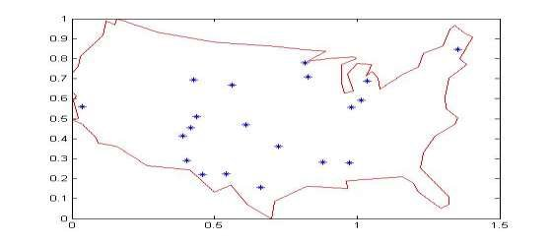
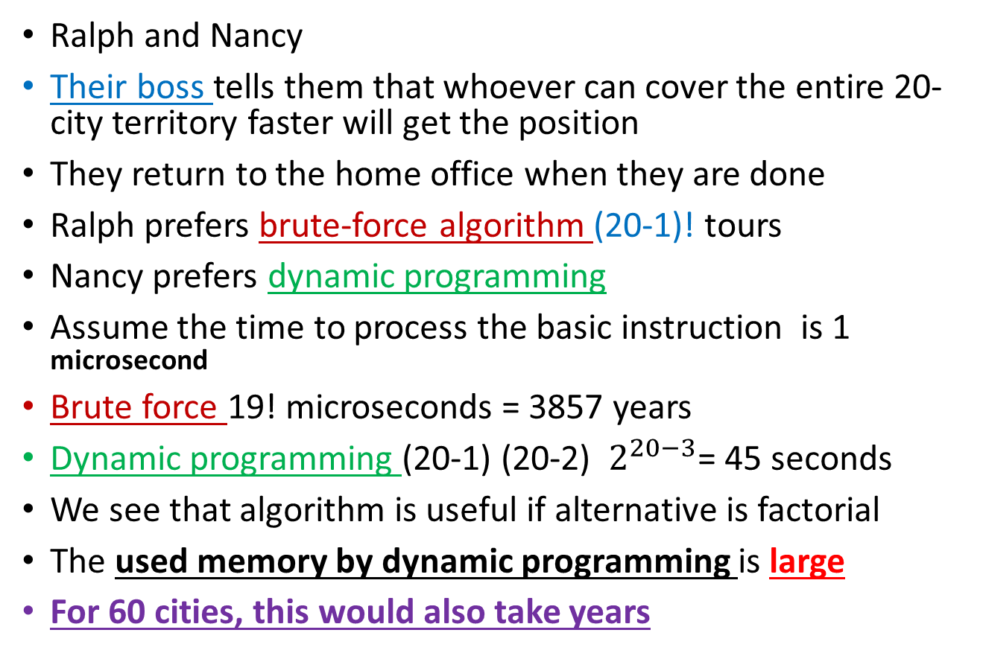
Is this algorithm useful? A case study
Ralph and Nancy
Their boss tells them that whoever can cover the entire 20-city territory faster will get the position
They return to the home office when they are done
Ralph prefers brute-force algorithm (20-1)! tours
Nancy prefers dynamic programming
Assume the time to process the basic instruction is 1 microsecond
Brute force 19! microseconds = 3857 years
Dynamic programming (20-1) (20-2) $2^{20−3}$= 45 seconds
We see that algorithm is useful if alternative is factorial
The used memory by dynamic programming is large
For 60 cities, this would also take years
No one has ever found an algorithm for this problem whose worst-case time complexity is better than exponential. Yet no one has ever proved that such an algorithm is not possible!

Slide 57
Approaches for Large Instances (n > 20)
For larger values of n (typically n > 20)
dynamic programming (e.g., Held-Karp) becomes computationally expensive
due to its O(n² * 2ⁿ) complexity
Alternative techniques to consider
Approximation Algorithms
Provide near-optimal solutions quickly, often with performance guarantees
Greedy Algorithm (quick but suboptimal): (CHAPTER 4)
Heuristic Methods
Use trial-and-error strategies to find good enough solutions in a reasonable time, but without guarantees of optimality
Genetic Algorithms: Inspired by natural selection: evolution through selection, crossover, and mutation
Simulated Annealing: Inspired by the annealing process in metallurgy, a technique used to remove defects in materials like metal or glass
Ant Colony Optimization: Inspired by ants' food-searching behavior (i.e., pheromone trails)
Exact Methods
Aim to find the exact optimal solution, but can be slow for large n due to the exhaustive search
Branch and Bound (CHAPTER 6)
Backtracking (CHAPTER 5) is not practical for large values of n

